Slide 1
Optimization
Solving NP Hard Problems
(Implementation in Python)
Dr. Prashant Singh Rana
psrana@gmail.com

Slide 2
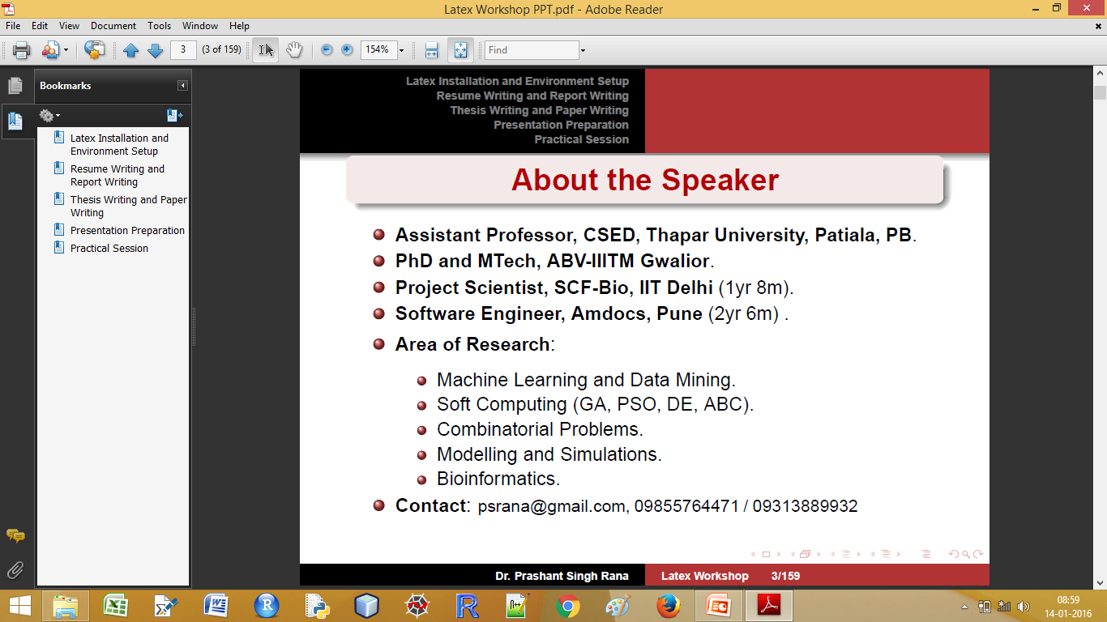

Slide 3
Outline
Introduction to Optimization
Genetic Algorithm (GA)
Particle Swarm Optimization (PSO)
Differential Evaluation (DE)
Ant Colony Optimization Algorithm (ACO)
Artificial Bee Colony Algorithm (ABC)
NP Hard Problems, Fitness Function
Applications Areas, Examples

Slide 4
Most Important
Learning by Doing

Slide 5
Skill Sets Required
Good Programming Skills.
Knowledge of any of the programming language (Python, R, Matlab, Octave)
Basics of Python
http://bit.ly/Rana-Python
Byte of Python
http://www.swaroopch.com/notes/python/

Slide 6
Basics of Python
Basics of Python
Basics of Python.txt
http://bit.ly/Rana-Python
Byte of Python
http://www.swaroopch.com/notes/python/

Slide 7
Sub Set Problem

Slide 8
Sub Set Problem 1
Problem Statement
Find the number of a subset from a set of numbers whose sum is zero.
Constraint: Subset size must be 5.
A={-12,-3,-6,7,2,-2,6,3,9,-7,-5,-8,1,11,-9,-4}

Slide 9
Subset Problem Heuristics Approach
Select Random Set of size 5
Calculate sum
Yes
If SUM is 0
Save set in list
No
Termination
Condition
Yes
No
Return list of sets

Slide 10
Sub Set Problem Implementation using python
03-SubSetProblem-1-Random.py

Slide 11
Sub Set Problem 2
Problem Statement
Find the number of a subset from a set of numbers whose sum is zero.
Constraint: Subset size must be 3 to 6 only.
A={-12,-3,-6,7,2,-2,6,3,9,-7,-5,-8,1,11,-9,-4}

Slide 12
Sub Set Problem Implementation using python
03-SubSetProblem-2-Random.py

Slide 13
Application of Sub Set Problem

Slide 14
Application of Sub Set Problem
Combo Offer by online portal
e.g. – Flipcart, Amazon, Snapdeal, etc.

Slide 15
Objective Function

Slide 16
Assignment – 1 Write the Python Code for
Minimize the Schewel Function
D = 10
Range = {-10, 10}
Output: List parameters x0, x1, ........ x9 and Min value.

Slide 17
Solution – 1 (version 1)
def FitnessFunction (x):
s=0
p=1
for i in range(0, D):
s = s + abs(x[i])
for i in range(0, D):
p= p * (x[i])
return s + p

Slide 18
Solution – 1 (version 2)
def FitnessFunction (x):
s=0
p=1
for i in range(0, D):
s = s + abs(x[i])
p= p * (x[i])
return s + p

Slide 19
Assignment – 2 Write the Python Code for
Minimize the Bohachevsky Function
D = 2
Range = {-100, 100}
Output: List parameters x1 and x2 and Min value.

Slide 20
Solution – 2
import math as m
def FitnessFunction (x):
s = x[0] * x[0] + 2 * x[1] * x[1]
– 0.3 * m.cos ( 3 * m.pi * x[0])
– 0.4 * m.cos ( 4 * m.pi * x[1])
+ 0.7
return s

Slide 21
Randomization

Slide 22
Randomization
Generate random number between 0 and 1.
import random
random.random()
It is similar to rand() function in excel.

Slide 23
Randomization
Generate integer random number between range.
import random
random.randint(1, 100)
random.randint(-10, 10)

Slide 24
Randomization
Generate real random number between range.
import random
random.uniform(1, 100)
random.uniform (-10, 10)

Slide 25
Assignment 3 Randomization
Explore different random number generation methods.
e.g. Uniform, logarithmic, Gaussian, etc.

Slide 26
Randomization - Sampling
Sampling: Choose N samples from a list
import random
A=[1, 2, 3, 4, 5, 6, 7, 8, 9, 10]
random.sample(A, 4)
random.sample(A, 2)

Slide 27
Randomization - Sampling
Sampling: Choose two numbers b/w
1 and 90
import random
random.sample(range(1,90), 2)
random.sample(range(1,90), 5)

Slide 28
Randomization - Sampling
Sampling: Generate random string of size N.
import string
import random
random.sample(string.ascii_letters, 5) "".join(random.sample(string.ascii_letters, 5))

Slide 29
Randomization - Sampling
Sampling: Generate random digit of size N.
import string
import random
random.sample(string.digits, 5) "".join(random.sample(string.digits, 5))

Slide 30
Randomization - Sampling
Sampling: Generate random string + digit of size N.
import string
import random
random.sample(string.digits + string.ascii_letters, 5)
"".join(random.sample(string.ascii_letters + string.digits, 5))

Slide 31
Randomization
How to check the goodness of the random function?

Slide 32
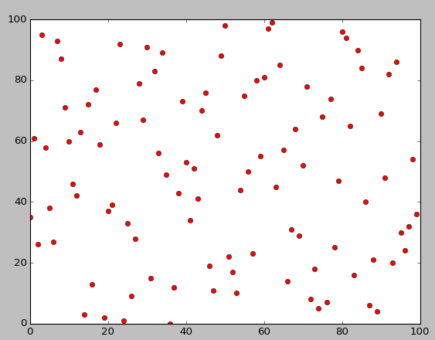
Randomization

Slide 33
Randomization
How to check the goodness of the random function?
import matplotlib.pyplot as plt
import random
plt.plot(random.sample(xrange(100), 100), 'ro')
plt.show()

Slide 34
Optimization

Slide 35
Optimization
Definition of optimization:
An act, process, or methodology of making something (as a design, system or decision) as fully perfect, functional or effective as much as possible.
Specifically the mathematical procedures (as finding the minimum/maximum of a function) involved in this.

Slide 36
Parameter Selection

Slide 37
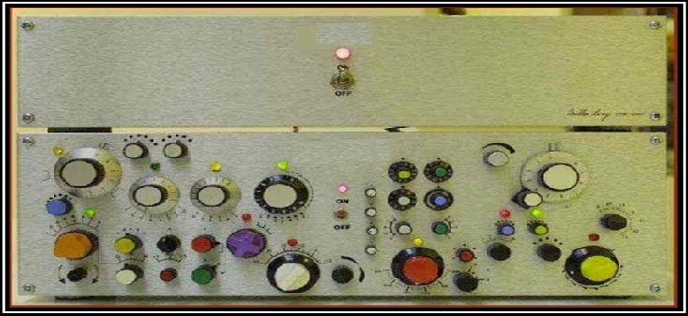
Parameter Selection

Slide 38
Parameter Selection
Example:
f(x) = x1 + x2 + x3 + x4 + x5 + x6 + x7 + x8
x1 = [ 10, 100], x2 = [-9, 0]
x3 = [ -50, -10], x4 = [-20, -10]
x5 = [ 0, 1], x5 = [0.1, 0.5]
x7 = [ -1, 0], x6 = [-5.0, -1.0]
Objective:
What are the values of parameters gives f(x) minimum value?

Slide 39
Optimization using Randomization
Start
BestFitness = 9999; BestParameter = None
X = Generate random set of parameters
Calculate fitness value for X
If fitness <
BestFitness
Yes
BestParameter = X
No
No
STOP
Condition
Yes
Return BestParameter

Slide 40
Python Implementation Optimization using Randomization
Go to “Python Optimization Programs”
01-Random Chromosome.py
02-Random Optimization.py

Slide 41
Assignment – 4 Optimize using Randomization
Minimize the Schewel Function
D = 10
Range = {-10, 10} // Real values
Output: List parameters x0, x1, ........ x9 and Min value.

Slide 42
Assignment – 5 Optimize using Randomization
Minimize the Bohachevsky Function
D = 2
Range = {-100, 100}
Output: List parameters x1 and x2 and Min value.

Slide 43
Assignment – 6
Optimize ten benchmark problems using randomization and draw convergence graph.
Go to
http://bit.ly/SoftComputing-Books
Nature-Inspired Optimization Algorithms.pdf
Appendix A

Slide 44
Genetic Algorithm

Slide 45


Genetic Algorithm
Kids in 1950 and 2016

Slide 46
Genetic Algorithm
It is a heuristic method based on Darwin’s theory i.e. survival of the fittest.

Slide 47
Genetic Algorithm
It is a heuristic method based on Darwin’s theory i.e. survival of the fittest.
Useful when search space is very large or too complex for analytic treatment.

Slide 48
Genetic Algorithm
It is a heuristic method based on Darwin’s theory i.e. survival of the fittest.
Useful when search space is very large or too complex for analytic treatment.
To search a through a huge combination of parameters to find the best match.

Slide 49
Genetic Algorithm
Example:
Search through different combinations of materials and designs to find the perfect combination of both which could result in a stronger, lighter and overall, better final product.

Slide 50
Parameter Selection

Slide 51
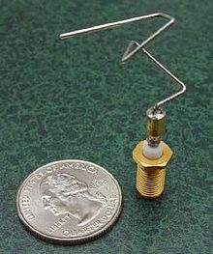
Genetic Algorithm

Slide 52
Genetic Algorithm
NASA ST5
spacecraft antenna, 2006.

Slide 53
Genetic Algorithm
This complicated shape was found by an evolutionary computer design program to create the best radiation pattern.
NASA ST5 spacecraft antenna, 2006.

Slide 54
GA - Workflow
Initial Random Population
PopSize=100
Crossover
Mutation
Selection
(Evaluate Fitness)

Slide 55
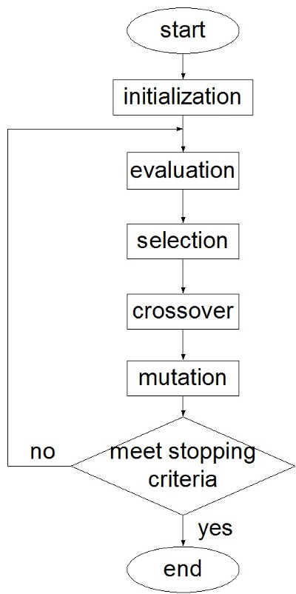
GA
Work flow

Slide 56
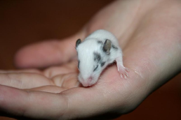
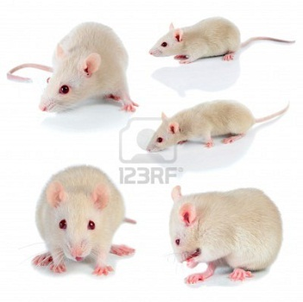
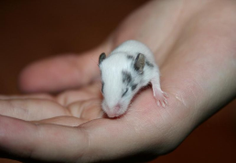
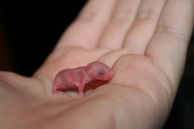
Genetic Algorithm
Parent selection
Initialization
Survivor selection
Recombination
Mutation
termination

Slide 57
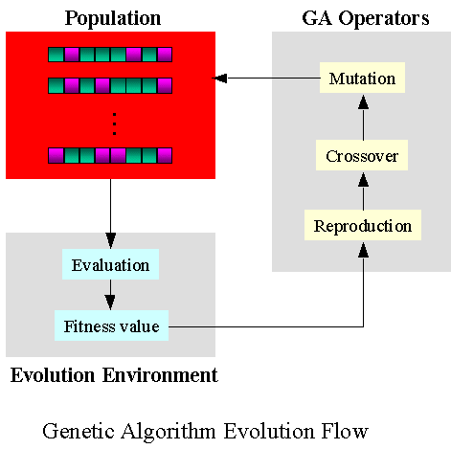
GA
Work flow

Slide 58
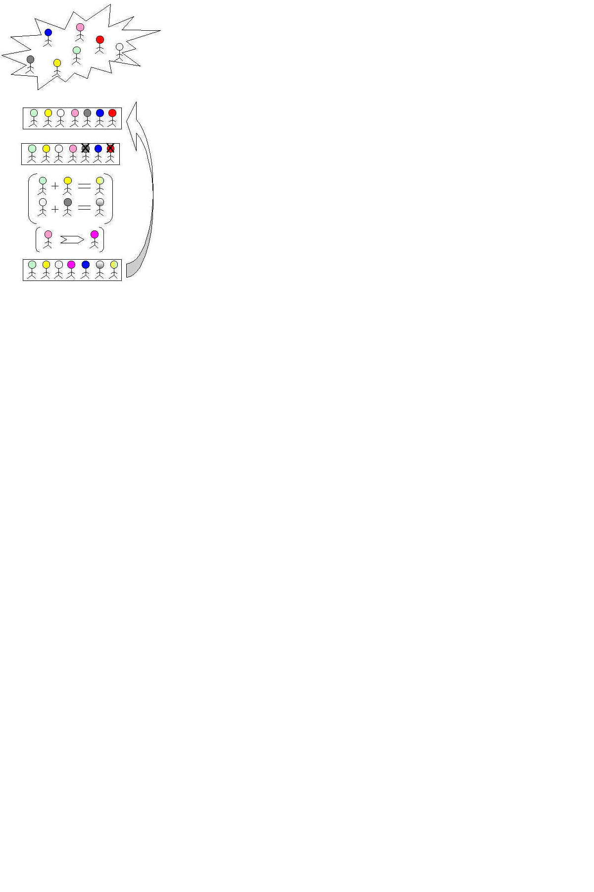
GA
Work flow

Slide 59
GA: Basic principles
Coding or Representation
Binary, integer number, real number, String.

Slide 60
GA: Basic principles
Coding or Representation
Binary, integer number, real number, String.
Fitness function
Parent selection

Slide 61
GA: Basic principles
Coding or Representation
Binary, integer number, real number, String.
Fitness function
Parent selection
Reproduction
Crossover
Mutation

Slide 62
GA: Basic principles
Coding or Representation
Binary, integer number, real number, String.
Fitness function
Parent selection
Reproduction
Crossover
Mutation
Convergence
When to stop

Slide 63
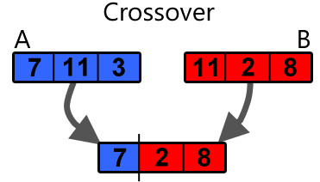
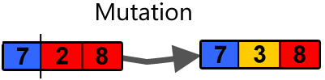
GA: Crossover/Mutation

Slide 64
GA: Crossover/Mutation
Crossover → for Exploration
Mutation → for Exploitation

Slide 65
GA Simulations using python
Generate Random Population
02-GA-Part-I.py
Crossover and mutation
02-GA-Part-II.py
Complete GA Implementation
02-GA-Part-III.py

Slide 66
GA: Tuning Parameters
Population Size: 50, 100
Crossover Rate: 0.5 to 0.9
Mutation Rate: 0.01
Fitness Function

Slide 67
Assignment – 7
Optimize ten benchmark problems using randomization and GA. Make the Comparison b/w them and draw convergence graph.
Go to
http://bit.ly/SoftComputing-Books
Nature-Inspired Optimization Algorithms.pdf
Appendix A

Slide 68
Assignment – 8
There are two parents and two childs: P1, P2, C1 and C2. How to choose best two (having maximum value) and save in P1 in P2?

Slide 69
Answer 8
int x1,x2; if(c1>p1 && c1> c2) {x1=c1; c1=p1;} else if (c2>p1 && c2>c1) {x1=c2; c2=p1;} else {x1=p1;} if (c1>p2 && c1> c2) {x2=c1;} else if (c2>p2 && c2>c1) {x2=c2;} else {x2=p2;} p1=x1; p2=x2

Slide 70
Evaluation Parameters for Algorithm

Slide 71
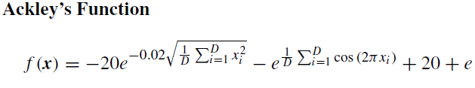
Evaluation Parameters for Algorithm
subject to −35 ≤ xi ≤ 35.
The global minimum is located at origin
x∗ = (0, . . . , 0)
With f (x∗) = 0.

Slide 72
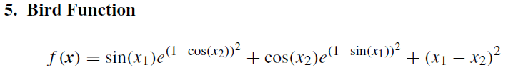
Evaluation Parameters for Algorithm
subject to −2π ≤ xi ≤ 2π.
Two global minima are located at
x∗ = (4.701, 3.152) and (−1.582,−3.130)
with f (x∗) = −106.764537.

Slide 73
Evaluation Parameters for Algorithm
1. Success Rate
How many time algorithm to get Objective value.
SR = No. Of Success / Total No. Of Runs

Slide 74
Evaluation Parameters for Algorithm
2. Average Function Evaluation
Number of function Evaluation (fitness function calls) required to get Objective value.
AFE = No. Of FE / Total No. Of Runs

Slide 75
Evaluation Parameters for Algorithm
3. Mean Error
ME = abs (OB – OV)/ Total Runs
OB → Objective Value
OV → Optimum Value getting from Algorithm

Slide 76
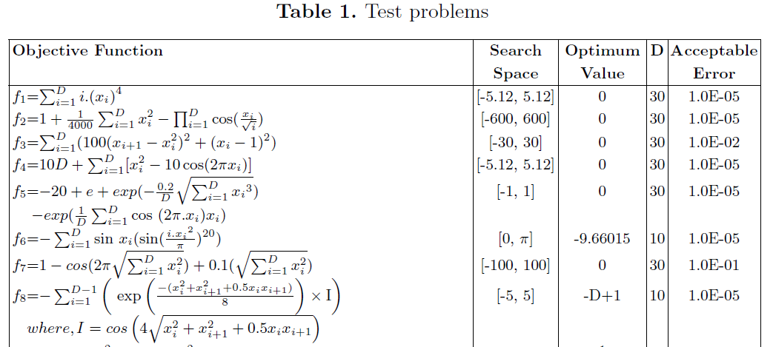
Evaluation Parameters for Algorithm

Slide 77
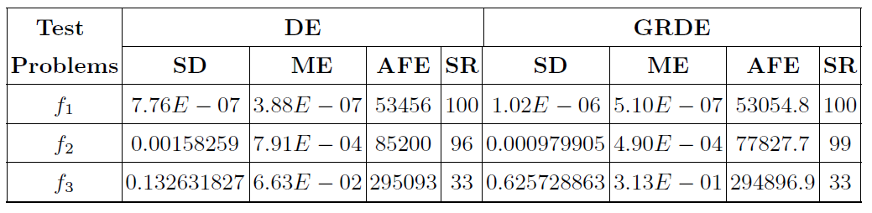
Evaluation Parameters for Algorithm

Slide 78
Review GRDE Paper
Open GRDE.pdf

Slide 79
Optimization Toolbox Demo
Explore
GUI Softcomputing Optimization ToolBox.jar

Slide 80
One page Writing
To improve technical writing:
Write Abstract and Conclusion of any good Journal (e.g. IEEE Transaction).
Repeat the practice for 60 days (2 Months).
Checked weekly in the lab.

Slide 81
Sandeep Maheshwari
Watch the videos of
Sandeep Maheshwari

Slide 82
Assignment – 9
Explore GA Optimization ToolBox of Matlab
Go to → www.YouTube.com
Search for “Genetic Algorithm Optimization in Matlab”

Slide 83
How to merge the results of different Algos for same fitness function

Slide 84
How to merge the results of different Algos
Step I
Define Fitness Function in → fitness.py
Step II
Import the Fitness Function file in to algo program
from fitness import FitnessFunction
GA.py Random.py DE.py ABC.py
Step III
Merge Results and Plotting → Merge.py

Slide 85
How to merge the results of different Algos
python Demo
05-MergeAndPlot.py

Slide 86
Differential Evolution (DE)

Slide 87
Differential Evolution (DE)
More on
Nature Inspired Optimization Algorithms → Chapter 6

Slide 88
Differential Evolution (DE)
It was developed in R. Storn and K. Price in 1996.

Slide 89
Differential Evolution (DE)
It was developed in R. Storn and K. Price in 1996.
It is a vector-based metaheuristic algorithm.

Slide 90
Differential Evolution (DE)
It was developed in R. Storn and K. Price in 1996.
It is a vector-based metaheuristic algorithm.
It converges fast.

Slide 91
Differential Evolution (DE)
It was developed in R. Storn and K. Price in 1996.
It is a vector-based metaheuristic algorithm.
It converges fast.
Best suited for real type chromosomes.

Slide 92
Differential Evolution (DE)
Python Demo

Slide 93
Set Partition Problem

Slide 94
Set Partition Problem
Problem Statement
Partition a set into two sub sets such that the difference between sum of subsets is min. Constraint: Difference in set size should not be greater than 5.
A=[12,23,26,27,22,25,36,13,39,17,15,18,21,11,19,14]

Slide 95
Set Partition Problem Implementation using python
06-Set Partition Problem-Random.py

Slide 96
Assignment – 10
A set S contain even number of elements,
partition S into two sub sets (S1 and S2) such
that the difference between the sum of subsets
is min. Write a program to find all the sub
sets for (difference in set size):
(i) SetSize(S1) - SetSize(S2) == 0
(ii) SetSize(S1) - SetSize(S2) == 2
(iii) SetSize(S1) - SetSize(S2) == 4

Slide 97
Assignment – 11
A set S contain even number of elements,
partition S into two sub sets (S1 and S2) such
that the difference between the sum of subsets
is min. Write a program to find all the sub
sets whose set size difference is between (0
and 6).

Slide 98
Travelling Salesman Problem

Slide 99
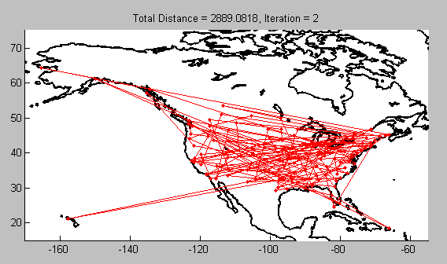
Travelling Salesman Problem

Slide 100
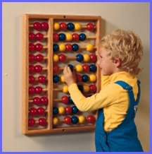
Travelling Salesman Problem
Mathematical Attempts at TSP
Testing every possibility would require N! separate additions
For a 15 city tour:
15! = 1.31 x 10¹² separate calculations
Assuming 1 million calculations per second → 15.2 days
Increasing complexity…

Slide 101
Travelling Salesman Problem
Heuristics Approach
Generate Tours
Calculate Cost
Save If Min
No
Termination
Condition
Yes
Return Min Tour

Slide 102
Travelling Salesman Problem Implementation using python
07-Travelling SalesMan Problem-TourGeneration.py

Slide 103
Lab Evaluation
Date: 17th Feb, 8-10 AM
Solve two problems using Random, GA, DE.
Submit the best results (best chromosomes, and best fitness value) of each algo for each problem (link will be provided; Total Submission = 2 * 3 = 6)
Plot the convergence graph for all the algorithm for each problem (Two Graph).
Assignment Register (5 Problems with Statement + Python Code)

Slide 104
How to call external Commands

Slide 105
Call external command
In python
import os
os.system(“calc”)
os.system(“notepad”)
os.system("python random.py")
os.system("python ga.py")
os.system("python decisionTree.R")
os.system("python randomForest.R")

Slide 106
Call external command
In R
system(“calc”)
system(“notepad”)
system("python random.py")
system("python ga.py")
system("python decisionTree.R")
system("python randomForest.R")

Slide 107
Call external command
In Octave/Matlab
system(“calc”)
system(“notepad”)
system("python random.py")
system("python ga.py")
system("python decisionTree.R")
system("python randomForest.R")

Slide 108
Call external command
In C/C++/Java
system(“calc”)
system(“notepad”)
system("python random.py")
system("python ga.py")
system("python decisionTree.R")
system("python randomForest.R")

Slide 109
Linear Model

Slide 110
Linear Model
f(x) = w1x1 + w2x2 + w3x3 + w4x4 + w5x5 + w6x6
Where, w1, w2, w3, .... are the weights.
x1, x2, x3, ...... are the features.
How find the optimize weights?

Slide 111
Least Sum of Square

Slide 112
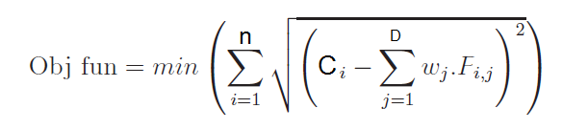
Least Sum of Square
n = Total number of Observations (Rows)
C = Target (Class)
D = Dimension of the Problem (# of Features)
w = weight defined between [0,1]
F = Features

Slide 113
Find Least Sum of Square
Problem 1
w | 0.2 | -0.3 | 0.1 | -0.5 | 0.9
C | F1 | F2 | F3 | F4 | F5
30 | 3 | 5 | 7 | 9 | 10
50 | 1 | 7 | 5 | 10 | 15
80 | -15 | 15 | 10 | 5 | 10
90 | 20 | 0 | 2 | 3 | 7

Slide 114
Find Least Sum of Square
Problem 2
w | -0.2 | 0.3 | -0.1 | 0.5 | -0.9
C | F1 | F2 | F3 | F4 | F5
30 | 3 | 5 | 7 | 9 | 10
50 | 1 | 7 | 5 | 10 | 15
80 | -15 | 15 | 10 | 5 | 10
90 | 20 | 0 | 2 | 3 | 7

Slide 115
Least Sum of Square
Find the optimized weight using Random
Demo → Python Code
08-Least Sum of Square - Random.py

Slide 116
Least Sum of Square
Find the optimized weight using GA
Demo → Python Code
08-Least Sum of Square - GA.py

Slide 117
Least Sum of Square
Find the optimized weight using DE
Demo → Python Code
08-Least Sum of Square - DE.py

Slide 118
Least Sum of Square
Find the optimized weight using PSO
Demo → Python Code
08-Least Sum of Square - PSO.py

Slide 119
Least Sum of Square
How to make the prediction using Optimized weights?

Slide 120
Least Sum of Square
How to make the prediction using Optimized weights?
Approach:
1. Find the weights using 70% Data.
2. Test the equation on 30% Data.

Slide 121
Particle Swarm Optimization (PSO)

Slide 122
Particle Swarm Optimization (PSO)
More on
Nature Inspired Optimization Algorithms
→ Chapter 7

Slide 123
Particle Swarm Optimization (PSO)
Particle swarm optimization (PSO) was developed by Kennedy and Eberhart in 1995.

Slide 124
Particle Swarm Optimization (PSO)
Particle swarm optimization (PSO) was developed by Kennedy and Eberhart in 1995.
It is based on swarm behavior in nature, such as fish and bird schooling.

Slide 125
Particle Swarm Optimization (PSO)
Particle swarm optimization (PSO) was developed by Kennedy and Eberhart in 1995.
It is based on swarm behavior in nature, such as fish and bird schooling.
PSO has been applied to almost every area in optimization, computational intelligence, and design applications.

Slide 126
Particle Swarm Optimization (PSO)
Particle swarm optimization (PSO) was developed by Kennedy and Eberhart in 1995.
It is based on swarm behavior in nature, such as fish and bird schooling.
PSO has been applied to almost every area in optimization, computational intelligence, and design applications.
More than two dozen PSO variants, and hybrid algorithms existing.

Slide 127
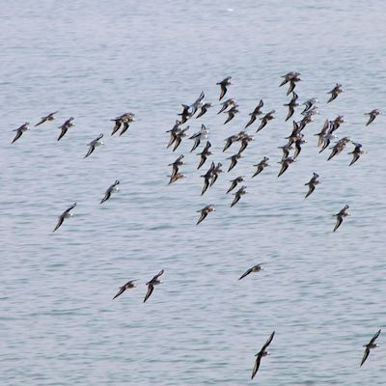
Particle Swarm Optimization (PSO)

Slide 128

Particle Swarm Optimization (PSO)

Slide 129
Particle Swarm Optimization (PSO)
Main theme is → Group Intelligence

Slide 130
Particle Swarm Optimization (PSO)
Four Terms:
1. Particle → Chromosome

Slide 131
Particle Swarm Optimization (PSO)
Four Terms:
1. Particle → Chromosome
2. Velocity → Moving speed of particle

Slide 132
Particle Swarm Optimization (PSO)
Four Terms:
1. Particle → Chromosome
2. Velocity → Moving speed of particle
3. Pbest → Individual best fitness

Slide 133
Particle Swarm Optimization (PSO)
Four Terms:
1. Particle → Chromosome
2. Velocity → Moving speed of particle
3. Pbest → Individual best fitness
4. Gbest → Best among population.

Slide 134
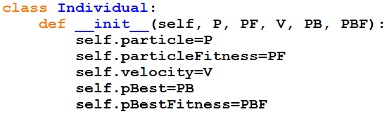
Particle Swarm Optimization (PSO)
Implementation:
Storing Particle, ParticleFitness, Velocity, PBest, PBestFitness

Slide 135
Particle Swarm Optimization (PSO)
Implementation:
Particle → vector type (array)
ParticleFitness → single value
Velocity → vector type (array)
Pbest → vector type (array)
PBestFitness → single value

Slide 136
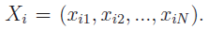
Particle Swarm Optimization (PSO)
Particle →
Velocity →
Pbest →

Slide 137
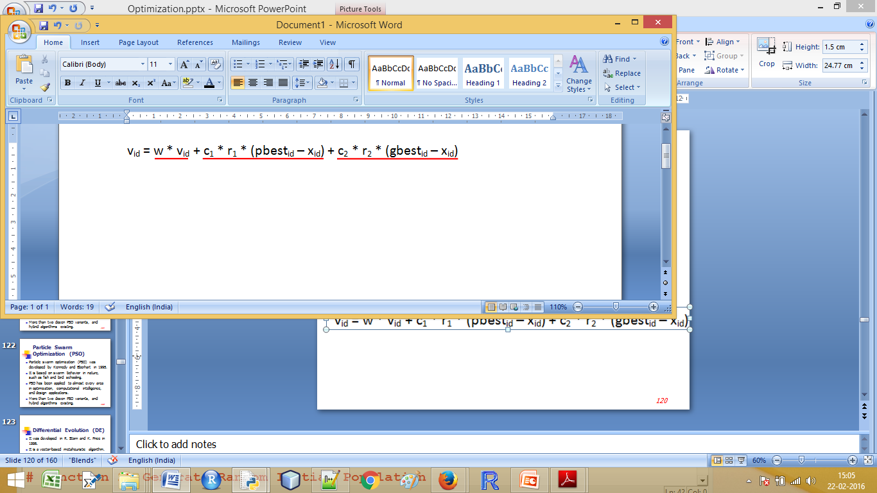
Particle Swarm Optimization (PSO)
Particle →
Velocity →
Pbest →
Velocity Update→

Slide 138
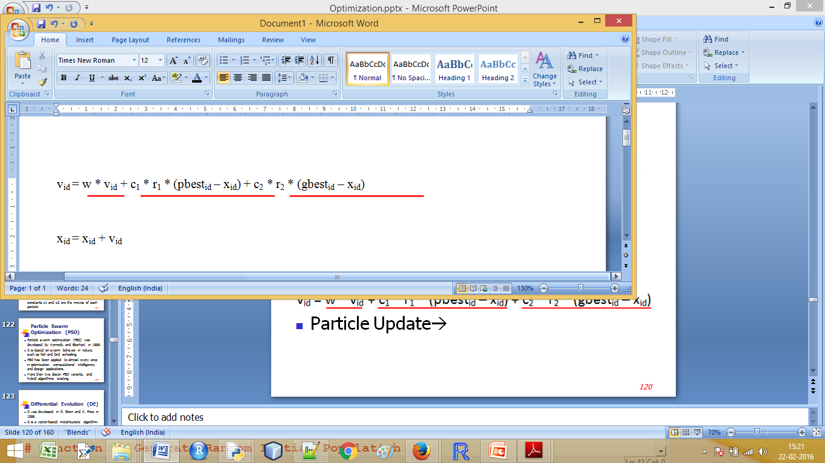
Particle Swarm Optimization (PSO)
Particle →
Velocity →
Pbest →
Velocity Update→
Particle Update→

Slide 139
Particle Swarm Optimization (PSO)
d = dimension of the problem.
w the inertia weight.
c1 and c2 are acceleration constants.
r1 and r2 are random number between range ∈ [0,1].

Slide 140
Particle Swarm Optimization (PSO)
w is a positive liner function of time changing according to generation iteration which provides a balance between local and global exploration.
The acceleration constants c1 and c2 are the moves of each particle towards pbest and gbest positions. High value results in fast movement of particle which may miss the global best and low value allow particle to move slow and being stuck in local minima.

Slide 141
Particle Swarm Optimization (PSO)
Python Demo
09-PSO.py

Slide 142
Particle Swarm Optimization (PSO)
Python Demo
Least sum of Square
10-Least Sum of Square - PSO.py

Slide 143
Thiel Fellowship
thielfellowship.org

Slide 144
Numerai Competition
Stock market prediction competition
www.numer.ai

Slide 145
Parameter Sensitivity

Slide 146
Parameter Sensitivity
Example: F in DE
STEP 1:Create a set of 50 benchmark functions.
Step 2: Evaluate every problem for 100 times
and record success rate for
F=0.1, 0.2, 0.3, 0.4,………….1
Step 3: Plot on Graph

Slide 147
Clique Problem

Slide 148
Clique Problem
Problem Statement
There is a weighted complete graph (of 100 nodes). Find a subset weighted complete (of 5 nodes) whose sum is maximum.
For More:
https://en.wikipedia.org/wiki/Clique_problem
https://en.wikipedia.org/wiki/Clique_%28graph_theory%29

Slide 149
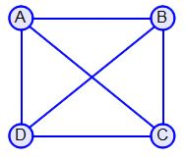
Clique Problem

Slide 150
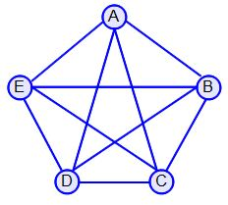
Clique Problem

Slide 151
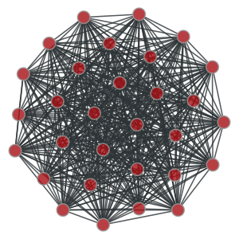
Clique Problem

Slide 152
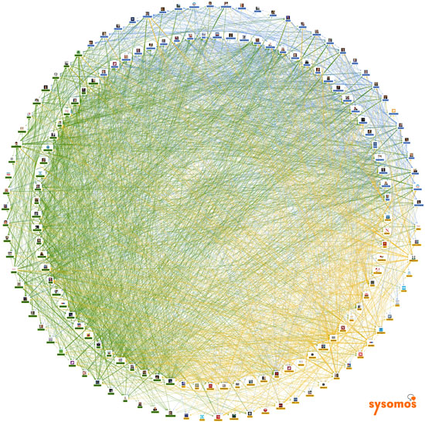
Clique Problem

Slide 153
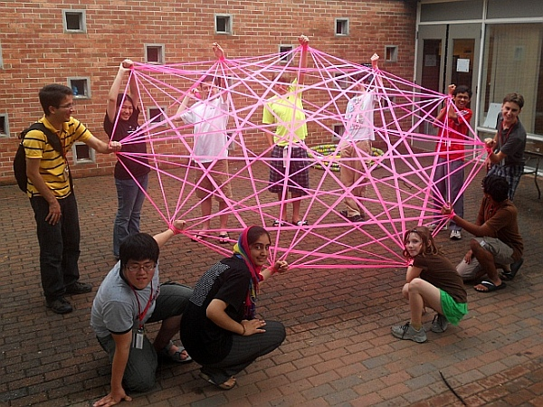
Clique Problem

Slide 154
Clique Problem Heuristics Approach
Select Random Nodes
Calculate Total Cost
Save If Cost Max
No
Termination
Condition
Yes
Return Max
wt. Nodes

Slide 155
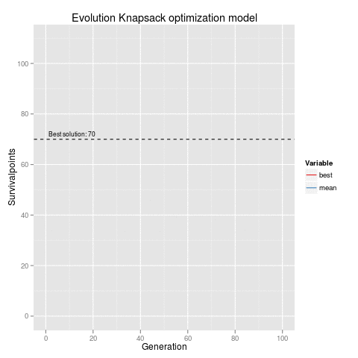
GA: Knapsack Problem

Slide 156
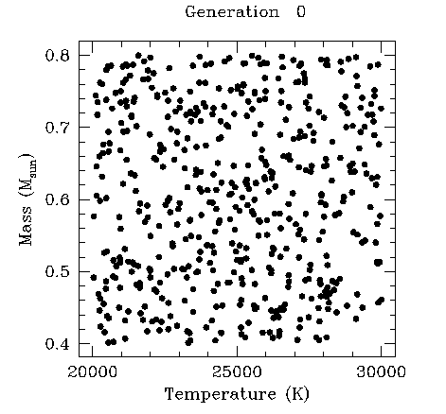
GA: Visualization

Slide 157
GA: Convergence

Slide 158
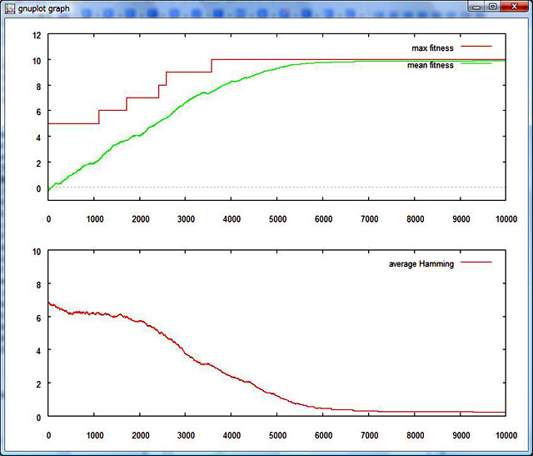
GA: Convergence

Slide 159
GA: Image Processing
Image quality improvement

Slide 160
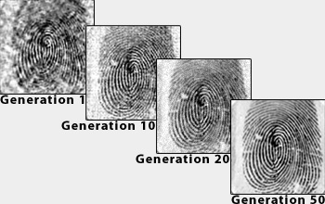
GA: Image Processing
Image quality improvement

Slide 161
GA: Solving Sudoku

Slide 162
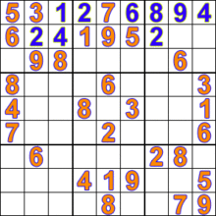
GA: Solving Sudoku

Slide 163
Coin Change Problem

Slide 164
Coin Change Problem
Problem Statement
There are coins of Rs 1, 5, 10 and 20. How many minimum number of coins are required to make Rs 1123.
Constraints: Total number of coins must be multiple of 5.

Slide 165
N Queens Problem

Slide 166
N Queens Problem
Problem Statement
In the N Queens puzzle you have an N by N chess board. On it you must place N queens so that no queen is threatening any other queen. Queens threaten any queen in the same row, column or diagonal.

Slide 167
N Queens Problem: Solution using GA
Objective: Minimize the number of attacks.

Slide 168
N Queens Problem: Solution using GA
Objective: Minimize the number of attacks.
The queens are initially placed in random rows and columns such that each queen is in a different row and a different column.

Slide 169
N Queens Problem: Solution using GA
Objective: Minimize the number of attacks.
The queens are initially placed in random rows and columns such that each queen is in a different row and a different column.
During each turn, A move is chosen that reduces the number of attacked queens on the board by the largest amount.

Slide 170
N Queens Problem: Solution using GA
Objective: Minimize the number of attacks.
The queens are initially placed in random rows and columns such that each queen is in a different row and a different column.
During each turn, A move is chosen that reduces the number of attacked queens on the board by the largest amount.
If there are several such moves, one is chosen at random, preferring moves that don't involve the same queen that was moved in the previous round.
Demo : http://yuval.bar-or.org/index.php?item=9

Slide 171
Next Class
GA implementation in Python.
Feature Selection using GA.
Weight optimization using GA.

Slide 172
Question & Doubts

